Slide 1
About MPAI
Leonardo Chiariglione, MPAI
15 UTC 13 March 2024
.

Slide 2
Who is MPAI?
Moving Picture, Audio, and Data Coding by Artificial Intelligence.
Established in Geneva, Switzerland.
International, Not-for-profit, unaffiliated organization.
Developing standards for AI-enabled Data Coding.
Data Coding is the format of data to suit a particular purpose.

Slide 3
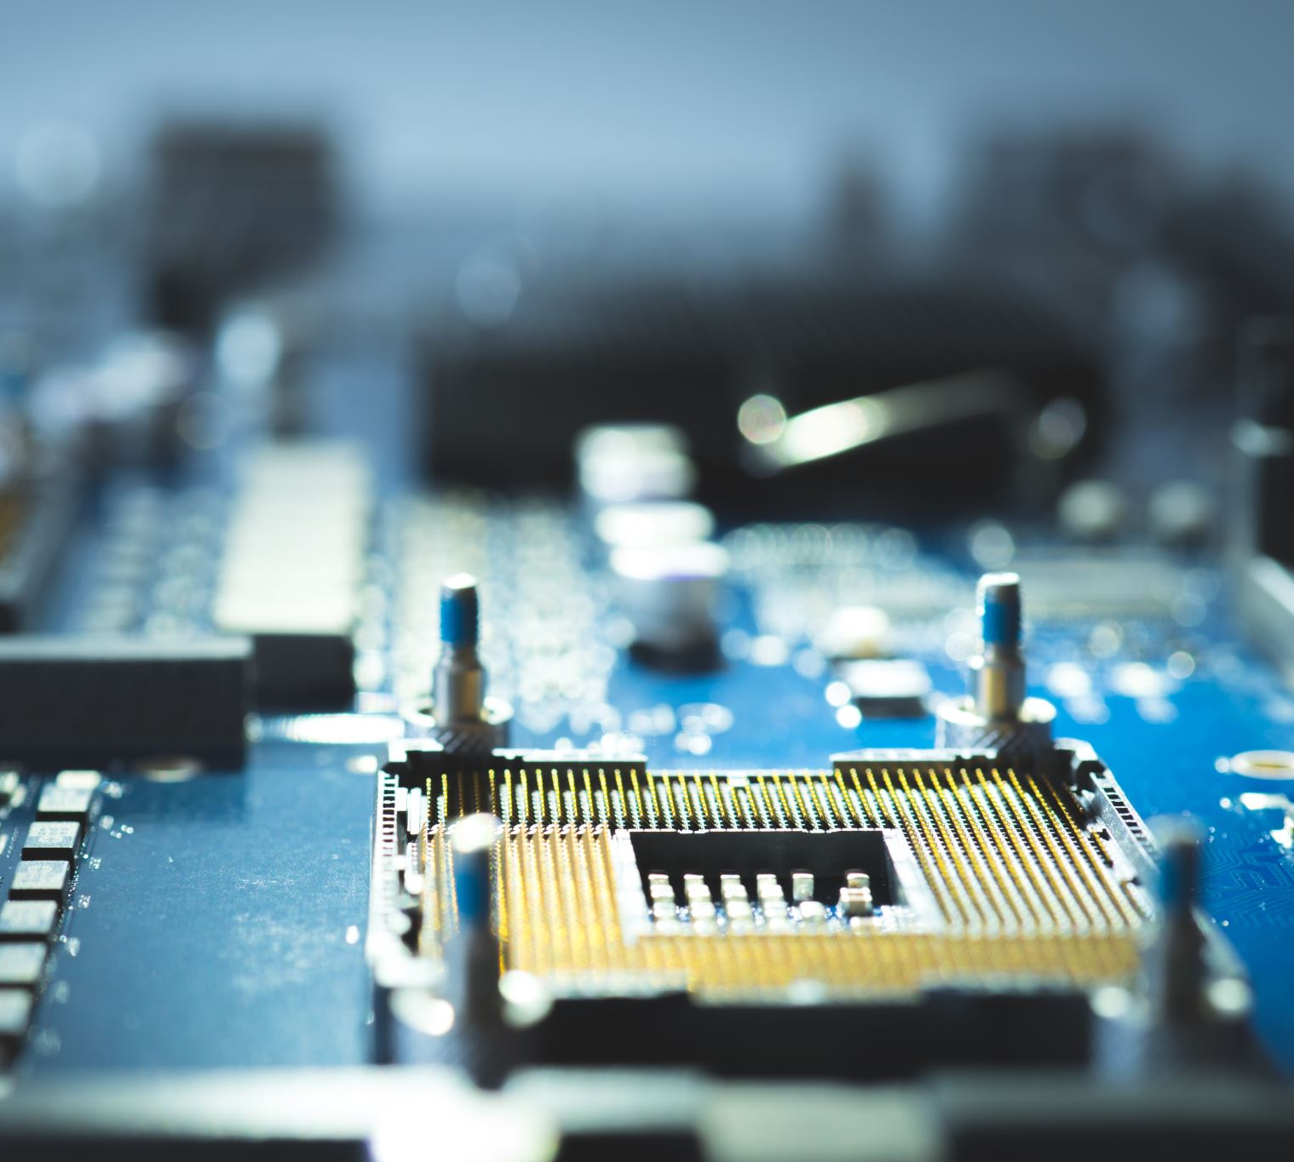
Why MPAI?
Products, Services, and Applications using Artificial Intelligence are growing by the day.
Most of them handle data without considering data format interoperability.
Standard data formats were at the root of the success of “data-processing” applied to media standards.
MPAI is the organisation applying the MPEG method to AI-enabled data coding.
But Artificial Intelligence is not Data Coding…

Slide 4
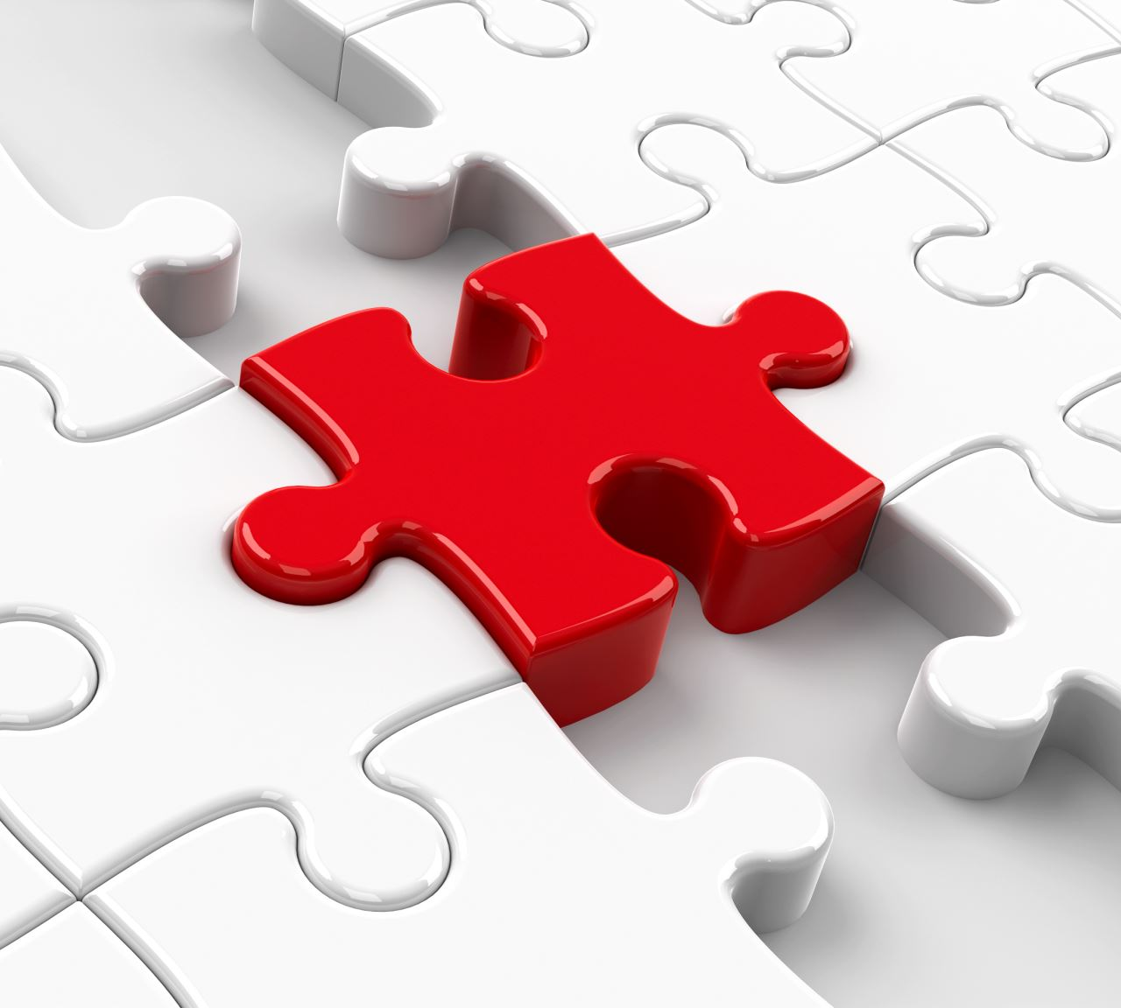
Standards for Artificial Intelligence
MPAI is not competing with standard bodies dealing with the foundations of AI.
Rather, MPAI strives to define interfaces between components having a function and requiring data from other components.
To the extent possible, data should have defined syntax and semantics.
This helps users to explain how an AI application works.

Slide 5
The MPAI organisation
General Assembly
Board of Directors
Membership& Nominating
Finance & Audit
Industry & Standards
IPR Support
Communication
Secretariat
Standing Committees
Development Committees
Requirements Standing Committee
AIF-DC
AIH-DC
CAE-DC
CUI-DC
GME-DC
MMC-DC
NNW-DC
PAF-DC
XRV-DC
CAV
MMM
EEV
EVC
SPG
24-Mar-15

Slide 6
MPAI develops standards with a rigorous process
Develop Use Cases and Functional Requirements.
Develop Commercial Requirements (Framework Licence).
Issue Call for Technologies with attached:
Functional Requirements.
Commercial Requirements.
Develop standard (MPAI members only).
Approve after publishing with request for Community Comments
Stage 0
Stage 1
Stage 2
Stage 3
Use Cases
Interest
Collection
Functional
Requirements
Commercial
Requirements
Technical
Specification
Reference
Software
Community
Comments
Standard
Development
Call for
Technologies
Conformance
Testing
Reference
Software
Performance
Assessment
Stage 7
Stage 6
Stage 5
Stage 4
Principal Members
All
All Members

Slide 7
MPAI standards for a better AI
MPAI’s AI standardisation is “component-based”.
An AI application is:
- Subdivided in smaller components: AI modules (AIM).
- Aggregated in one or more AI workflows (AIW).
- Executed in a standard environment (AIF).
1 foundational Technical Specification
AI Framework (MPAI-AIF)

Slide 8
The MPAI AI Framework
User Agent
AI Module (AIM)
AI Module (AIM)
Inputs
Outputs
AIM/AIW Storage
(non-secure)
AI Module (AIM)
AIM/AIW Storage
(secure)
AI Module (AIM)
Controller (Non-secure/Secure)
SAL
MPAI Store
Communi-cation
Global Storage
Access
Communication Service
Encryption Service
Attestation Service

Slide 9
Standards should be accessible & timely available
Before initiating a standard, Active Principal Members develop & adopt its Framework Licence (FWL), a licence without values: $, %, dates etc. declaring that the eventual licence will be issued
Not after products are on the market.
At a price comparable with similar standard technologies.
During the development, any Member making a contribution declares it will make its licence available according to the FWL.
After the development, Members holding IP in the standard select the preferred patent pool administrator.
Read the MPAI Patent Policy
2024-03-15
9

Slide 10
The MPAI ecosystem
MPAI
Implementer
NPAI Store
End User
Implementation
Standards (TS-RS-CT-PA)
Develops Implem-entations
Verifies security
Tests Conformance
Checks Performance
Down-loads Implem-entation
Performance Assessor
Technical Specification
Implementation
OK
Assesses Perfor-mance
OK
Implementation
Experience
Score
Performance Assessment
Conformance Testing
1 system Technical Specification:
Governance of the MPAI Ecosystem (MPAI-GME).

Slide 11
More published MPAI standards
1 - Context-based Audio Enhancement (MPAI-CAE) V2.1
2 - Compression and Understanding of Financial Data (MPAI-CUI) V1.1
3 - Connected Autonomous Vehicles (MPAI-CAV) – Architecture V1.1
4 – Human and Machine Communication (MPAI-HMC) V1.0
5 - Multimodal Conversation (MPAI-MMC) V2.1
6 - MPAI Metaverse Model (MPAI-MMM) – Architecture V1.1
7 - Neural Network Watermarking (MPAI-NNW) V1.0
8 – Object and Scene Description (MPAI-OSD) V1.0
9 - Portable Avatar Format (MPAI-ARA) V1.1

Slide 12
Other activities
2 Technical Reports
1 - MPAI Metaverse Model (MPAI-MMM) – Functionalities
2 - MPAI Metaverse Model (MPAI-MMM) – Functionality Profiles
Being developed
1 – Artificial Intelligence for Health (MPAI-AIH)
3 – Extended Reality Venues (MPAI-XRV) - Live Theatrical Stage Performance
New opportunities being explored
1 - AI-based End-to-End Video Coding (MPAI-EEV)
2 - AI-Enhanced Video Coding (MPAI-EVC)
3 - Server-based Predictive Multiplayer Gaming (MPAI-SPG)

Slide 13
MPAI and IEEE
MPAI Technical Specifications (being) adopted as IEEE standards
MPAI-AIF – 3301-2022
MPAI-CAE – 3302-2022
MPAI-MMC – 3300-2022
MPAI-CUI – 3303-2023
MPAI-NNW - 3304-2023
MPAI-CAV – Architecture (on its way)
MPAI-MMM – Architecture (on its way)
MPAI-OSD (on its way)
MPAI-PAF (on its way
All this achieved in 3 years!

Slide 14
In the 11-15 March week MPAI presents eight standards online
Standard | March | Reg.
AI Framework (MPAI-AIF) | 11 T16 | Link
Multimodal Conversation (MPAI-MMC) | 12 T14 | Link
Object and Scene Description (MPAI-OSD) | 12 T1 | Link
Context-based Audio Enhancement (MPAI-CAE) | 12 T17 | Link
Connected Autonomous Vehicle (MPAI-CAV) - Architecture | 13 T15 | Link
Human and Machine Communication (MPAI-HMC) | 13 T16 | Link
Portable Avatar Format (MPAI-PAF) | 14 T14 | Link
MPAI Metaverse Model (MPAI-MMM) - Architecture | 15 T15 | Link

Slide 15
We look forward to working
with you
on this exciting MPAI project!
Join MPAI
Share the fun
Build the future
https://mpai.community/
15
15
15
15

